Slide 1

$$ Online Stock Forecasting with Portfolio Management $$
Group-13 :
Milin Thiru
Bhavya Rakesh Vidur

Slide 2
Individual Group Member’s Contribution Breakdown
For this project, all group members have/will be contributing equally.
Phase Members
Project Meetings All Members
Data Collection All Members
UI development All Members
Designing Web Services and Database All Members
Designing Prediction Strategies All Members
Integration and Testing All Members
Report and Presentation All Members

Slide 3
Project Overview
Our Project Aim
Developing a web application which provides access to users, a reliable prediction of stock values of companies they are interested in.
Especially designed for active daily or weekly short-term investors, since they usually do not have the time or resources to avail of commercial forecasting services or hire agents.
Using Technical analysis
The technical analysis would based on the analysis if historical market data, we would get using Yahoo Finance APIs. We are collecting both the historical and real time data.
Development Environment
The programming language would preferably be JAVA for developing the web services and the database would be PostgreSQL database.

Slide 4
Project Overview
Our project would mainly focuses on three aspects:
Real time data feed
We have used real time data that is collected from Yahoo Finance API. So the prediction is based on real time data feeding and long term prediction is based on historical data, thus making it a realistic prediction advisory.
Prediction Strategies and Web Services
We are providing prediction for both long term and short term.
These algorithms run as a back-end task and compute the prediction values for the various stocks completely abstracted from the User.
Easy Access to Web Interface
The web application would be offering various functionalities to the end users like
Getting valuable information about the stocks.
Timely recommendations.
Some tips on how to deal with their current stocks etc.

Slide 5
Brief Literature Review
Website Name |  | Morningstar.com | SmartMoney.com | Wikinvest
Company |  | Morningstar, Inc. | SmartMoney Magazine | Wikinvest
Web Address |  | www.morningstar.com | www.smartmoney.com | www.wikinvest.com
Subscription Price |  | free to $21.95/mo. | free; $5.95/mo. or $58/yr. | free
Portfolio Updates (Frequency of Updates) |  | automatic (delayed quotes) | automatic (delayed quotes), real-time $58/yr. | automatic (delayed quotes)
Email Alerts (News/Price Targets/Dividends/Splits) |  | yes (news/dividends/splits) | yes (price targets) | yes (news)
Email Reports (Security Values/Market Summary) |  | yes (security values) | yes (security values) | yes (security values)
Additional Analysis Tools | Stock Screening/Mutual Fund Screening | yes | yes
 | Financial Planning | yes | yes
 | Interactive Charting | yes | yes | yes
Transactions Handled | Deposit/Withdrawal; Buy/Sell | yes | yes | yes
 | Short/Cover |  | yes | yes
 | Margin |  |  | yes
 | Dividends (Cash/Stock/Splits/Reinvest) | yes | yes | yes
 | Receive/Deliver Security
 | Interest Income | yes
 | Treatment of Fees/Commissions | yes | yes | yes
Reports | Current Holdings | yes | yes | yes
 | Holdings by Lots
 | Cash Portfolio Status | yes | yes | yes
 | Tax Schedules (Interest/Dividends/Capital Gains)
 | Projected Cash Flows
 | Customized Reports/Views | yes | yes | yes
Performance Reports | Security/Industry/Asset Class/Investment Style | yes (security) | yes (security/asset class) | yes (security/industry/asset class)
 | Portfolio (Single/Multiple) | yes (single) | yes | yes
 | Holding Period/Between Period Returns | yes | yes | yes (holding period)
 | Value-Weighted IRR/Time-Weighted Returns | yes | yes (time-weighted) | yes (time-weighted)
 | Tax-Adjusted Returns
 | Benchmark Comparison | yes | yes | yes
Import/Export Data |  | yes | yes | yes

Slide 6
Application Components
Portfolio
Admin
Prediction
&
Recommendation
Services
Client
Main Components

Slide 7
High-level Block Diagram
Web Services
Client User Interface
Yahoo Finance APIs
Application Interface
Admin User Interface
User
Google Trends APIs
Application Interface
Database Interface
DataBase
WEB SERVER

Slide 8
High-level Use Case
DataBase
Stock
Details
Create New Account
Graphs &
Charts
Client Portfolio
Client
Returning User
Short-Term
Prediction
View/Analyze Client Portfolios
Google Trends
Long-Term
Prediction
Login
Send Emails
Email Services
Admin

Slide 9


Why Stock Prediction ?
It’s all about $$$ ..
Why do anyone invest in stock markets ?
$. To become a part owner of the business
$. To receive profits which are named as Dividends.
Stocks are at a relatively high potential in terms of
returns when compared to mutual funds and bonds.
The potential comes at a price of high risk of losing
some or the total investments at times.
Hence, investors are interested in stock predictions.

Slide 10
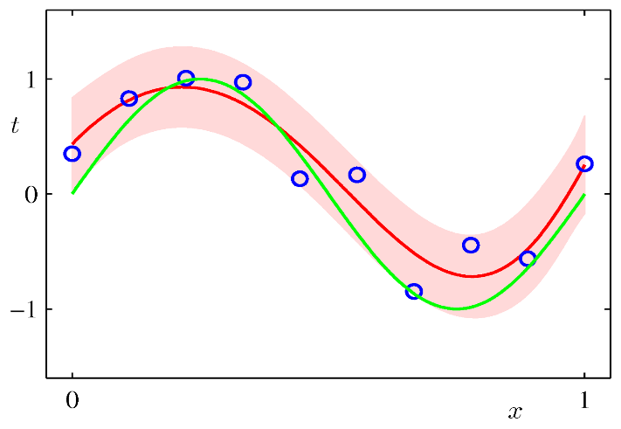
Short term Prediction Strategy - Bayesian
About Bayesian….
Curve fitting is the process of constructing a curve, or mathematical function, that has the best fit to a series of data points, possibly subject to constraints
Previous data is used to fit the curve and can be used to predict future value.
Bayesian linear regression is a prediction with the probability of random variable
To predict intra-day stock prices
Duration
Prediction window: 15 min to 1 day
Future prediction: 1 to 15 min

Slide 11
Long term Prediction Strategy – AI & Machine Learning
Artificial Intelligence is used as a key tool to predict the stocks based on long-term periods.
Machine Learning Technique: Support Vector Machine
Artificial Neural Networks

Slide 12

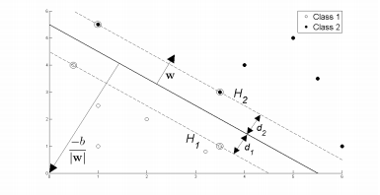
Support Vector Machines (SVM)
Support vector machines (SVM) are a set of supervised learning methods used for classification and regression analysis.
Given a set of training data SVM can classify data points as one of two classes.
This is done by intersecting a
hyperplane through the feature
space that separates one cluster
of similarly labeled training
data from another.

Slide 13
Advantages and Disadvantages of SVM
Advantages:
High Accuracy
Theoretical guarantees of resistance towards over-fitting data
Absence of local minima
Sparseness of the solution and capacity control.
Disadvantages:
High algorithmic complexity.
Choice of the kernel
Memory requirements are huge in large scale tasks

Slide 14
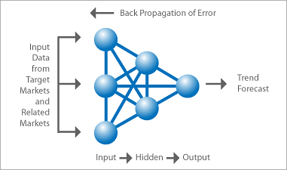
Artificial Neural Networks (NN)
Neural Networks are able to deal with uncertain, fuzzy, or insufficient data which fluctuate rapidly in very short periods of time, neural networks (NNs) have become very important method for stock market predictions.
In essence all forms of time series prediction
are fundamentally the same. Namely given
data x=x(τ) which varies as a function of time τ,
it should be possible to learn the function that
maps xτ+1=xτ.

Slide 15
Advantages and Disadvantages of Neural Networks
Advantages:
Neural networks often exhibit patterns similar to those exhibited by humans. However this is more of interest in cognitive sciences than for practical examples.
Easy to implement unlike SVN ( requiring good linear algebra )
Disadvantages:
Requires high processing time for large neural networks.

Slide 16
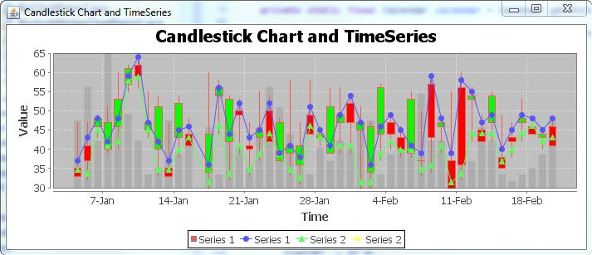
Displaying Patterns and Trends
We propose using patterns to reduce the uncertainty of forecast.
Candle Stick Pattern
Head and Shoulders
Google Trends :
Google Trends is a public web facility of Google Inc., based on Google Search, that shows how often a particular search-term is entered relative to the total search-volume across various regions of the world.
A stock price rise or fall can be correlated to its web search frequency

Slide 17

Decision Making ! – Our Recommendation Policy
Ultimately, the stock analysis is to make a decision whether to buy, sell or hold a stock.
Prediction Algorithms
w1
Raw Stock data
Decision ?
Buy / Sell / Hold
Google Trends data
w3
Our
Recommendation
Policy

Slide 18
Anticipated Web Services
Client User Interface
saveUserInfo()
IsExisitingUser()
getUserPersonalData()
updateUserPersonalData()
buyStock()
sellStock()
holdStock()
getLongTermPredictions()
getShortTermPrediction()
generateCandleStickPatternGraph()
generateHeadAndShoulderPatternGraph()
Admin Interface
getRegisterdUsers()
gerUserPersonalData()
getUserPortfolio()
sendEmails()
analyseUserPortfolio()

Slide 19
Anticipated Web Services
Application Interface
getHistoricalDataYahoo()
getRealTimeDataYahoo()
getLongTermPrediction()
getShortTermPrediction()
getFinalRecommendation()
runBayesian()
runSVM()
runNeuralNetworks()
getGoogleTrendValue()
Database Interface
getClientUserInfo()
insertClienUsertInfo()
updateClientUserInfo()
insertIntoDBHist()
insertIntoDBReal()
insertIntoClientUserPortfolio()
updateClientUserPortfolio()

Slide 20
Achieved Tasks
Project Phase 1 – Data Collection Module
Java module for Data Collection
Historical Data + Real-Time Data
Using Yahoo APIs
Bayesian Curve Prediction
Short Term Prediction Ready using Bayesian Curve Fitting
Database Design and Schema
Stock Data related schema have been completed and ready.
High-level System Use Case Diagram is completed.
Algorithm for Neural Networks
A basic prototype of working code of the algorithm is written and tested on a set of stock data.

Slide 21
Our Anticipated Plan of Work
Tasks | Feb-20 | Mar-06 | Mar-15 | Mar-27 | Apr-06 | Apr-15 | Apr-20 | Apr-27
Database Design
User Interface ( UI ) Design
Developing Database Interface Webservices
Developing User Interface Webservices
Developing Application Interface Webservices
Implementing Short-term Prediction Algo
Implementing Long Term Prediction - SVM
Implementing Long Term Prediction - NN
Integrating Google Trends in Application
System Testing and Debugging
Documentation and Presentations
 | Finished
 | Currently Working
 | Future Work

